Slide 2
The Creaking Grounds

Slide 3
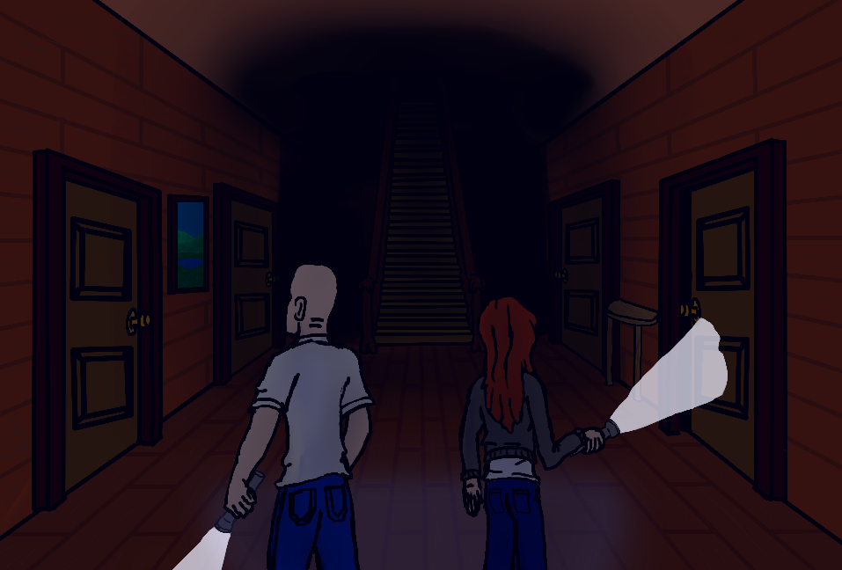
Razor Statement
Explore the old mansion collecting items to survive. But beware the cursed spirits of this house who lie in wait with surprises of their own.

Slide 4
User Story
You and your friends decide to venture into the haunted mansion in your town. You all thought it was just folktales, but little did you know, not all of you will make it home tonight. You will adventure around the mansion with your team to find equipment and uncover artifacts. Complete objectives with your teammates to reach the end. But be careful, for something may just set off the Curse’s Awakening and nothing has prepared you for that moment.

Slide 5
Game Features
Explore a randomly generated labyrinthine mansion
Create a character with stats to suit your play style
Search the rooms and containers for items and artifacts
Find hidden passages and secrets to help you win
Collect special powers from artifacts
Survive the Curse’s Awakening OR Destroy the trespassers as a Betrayer.

Slide 6
Why Are We Different?
Most horror games are linear and repetitive. Ours is not.
Multiplayer
We are an ambitious group that focuses on quality
Much accomplished in short time already = PROFIT SOONER FOR YOU

Slide 7

Demo

Slide 9
The Creaking Grounds

